Slide 1
Natural Language Processing
Justin Terry

Slide 2
Housekeeping
Videos are still very delayed, hopefully coming soon
Quizzes delayed until this is resolved, plan TBD
Matt’s now started grading homeworks, finished when he’s done
Half the class submitted parts of HW4 on time or very close
Over the past week, almost all of those people have submitted the rest of HW4
Almost no one who didn’t submit something in the initial wave has submitted anything now
What’s wrong?
New server instance finally up, this one should have fewer issues
Style transfer correction: https://www.cv-foundation.org/openaccess/content_cvpr_2016/papers/Gatys_Image_Style_Transfer_CVPR_2016_paper.pdf
I am explicitly not an NLP person, though I have largely automated a companies resume review system

Slide 3
What’s NLP and why are we talking about it
Language is important
Having our AI do things with language is important
NLP is a giant area of ML

Slide 4
How do you represent a language in numbers?

Slide 5
How do you represent a complex thing that’s a part of a set in numbers?

Slide 6
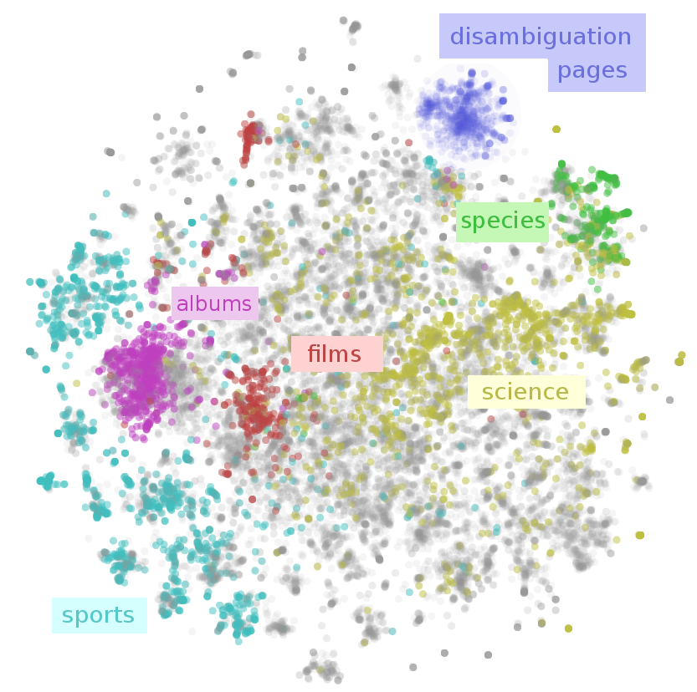

Slide 7
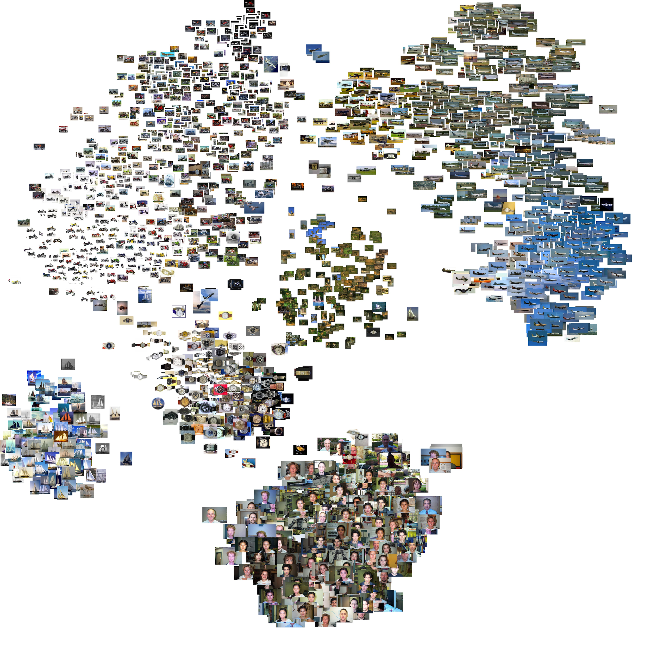

Slide 8
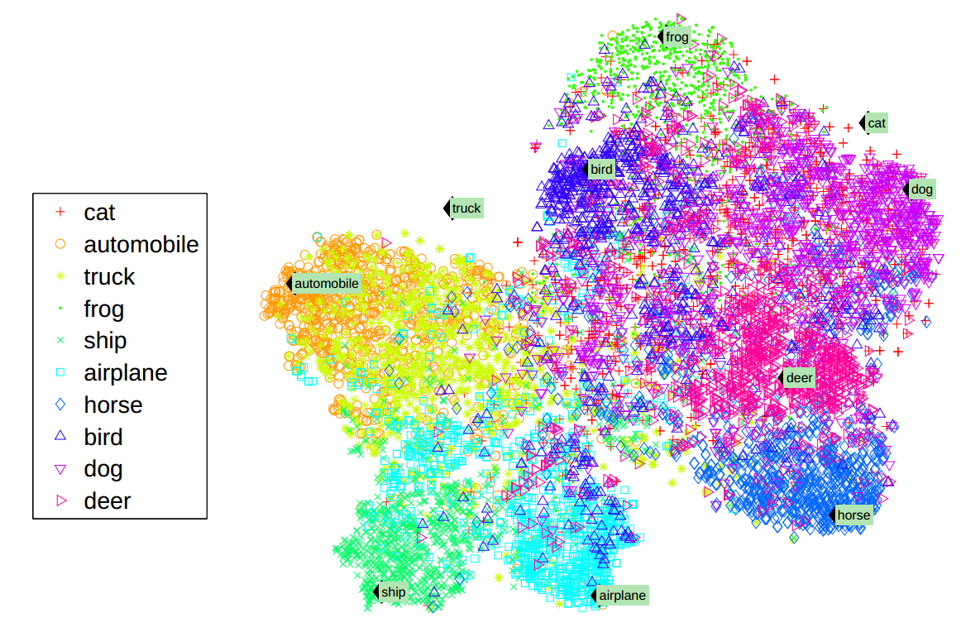

Slide 9
Vector Space Model
What’s an embedding?
Terminology
Meaning of vectors
Word is the only one with a complete enough theory for this class
If you only leave this lecture understanding one new thing, understand the concept of this modeling technique

Slide 10
How Do You Make Word Embeddings
Remove stop words
Word2vec
Skip-gram (order dependent) or CBOW (order agnostic in a window)
fastText (adds morphologies)
Hopefully this makes it clear why doing paragraphs, etc is so hard
Premade fancy ones are available for free

Slide 11
Libraries
NLTK
Gensim
SpaCy
Rake

Slide 12
Other things
Sentiment analysis
Sparse tensor problem
Much higher skill gap than other areas of ML

Slide 13
https://github.com/justinkterry/umdmlphysicistsclass/blob/master/lecture7/Gensim%20demo.ipynb

